Slide 1


JAVA Java Interview boot camp Core concepts
Lecture 20
CHAPTER 28
Code Optimization Using Lambda

Slide 2
Code optimization using lambda
(Clean & Optimized Code!)

Slide 3
Today’s Agenda
Using Lambda For Code Optimization
Lambdas And Multithreading
Examples
Lambdas And Collections
Examples

Slide 4
Recalling Multithreading
Multithreading is a Java feature that allows concurrent execution of two or more parts of a program.
Each part of such program is called a thread.
So, threads are light-weight processes within a process.

Slide 5
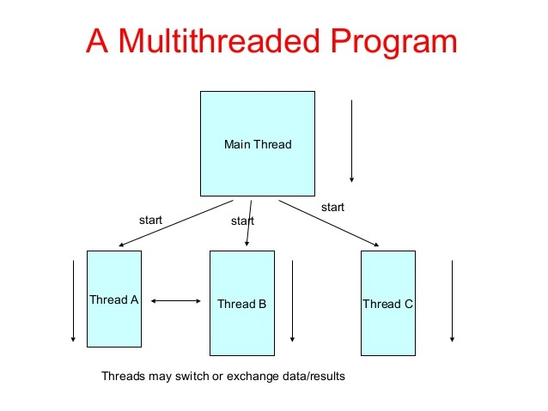
Recalling Multithreading

Slide 6
Advantages
Maximum utilization of CPU.
We can perform many operations together, so it saves time.
Threads are independent, so it doesn't affect other threads if an exception occurs in a single thread.

Slide 7
Java’s Model Of Multithreading
Threads in Java can be created by using two mechanisms:
By extending the Thread class
By implementing the Runnable Interface
Since we are going to use Lambdas with Multithreading so we will be discussing Multithreading with Runnable.

Slide 8
Steps Needed Before Java 8 To Implement Runnable
Before Java 8 , we used to do the following for implementing Runnable interface:
Create a new class which implements java.lang.Runnable interface.
Override the run() method.
Then we designed the driver class containing the main() method
Finally we instantiate a Thread object and call start() method on this object.

Slide 9
Example
class MyRunnable implements Runnable
{
@Override
public void run() {
try{
for(int i=2;i<=10;i+=2){
System.out.println("child thread:"+i);
Thread.sleep(200);
}
}
catch(InterruptedException ex){
System.out.println("child thread interrupted");
}
System.out.println("child thread finished!");
}
}
class ThreadingWithoutLambda {
public static void main(String[] args) {
MyRunnable mr=new MyRunnable();
Thread th=new Thread(mr);
th.start();
try{
for(int i=1;i<=10;i+=2){
System.out.println("main thread:"+i);
Thread.sleep(500);
}
}
catch(InterruptedException ex){
System.out.println("main thread interrupted");
}
System.out.println("main thread finished!");
}
}

Slide 10
Using Lambda With Runnable
From Java 8 , the above code can be re-written more concisely using Lambda Expressions with Runnable.
So we won’t have to write the boilerplate code like creating the implementation class and writing the prototype of the run() method.

Slide 11
Example
class ThreadingWithLambda {
public static void main(String[] args) {
Runnable mr=()->{
try{
for(int i=2;i<=10;i+=2){
System.out.println("child thread:"+i);
Thread.sleep(200);
}
}
catch(InterruptedException ex){
System.out.println("child thread interrupted");
}
System.out.println("child thread finished!");
};
Thread th=new Thread(mr);
th.start();
try{
for(int i=1;i<=10;i+=2){
System.out.println("main thread:"+i);
Thread.sleep(500);
}
}
catch(InterruptedException ex){
System.out.println("main thread interrupted");
}
System.out.println("main thread finished!");
}
}

Slide 12
Collections And Lambdas
Another important use of Lambdas is to simplify sorting of Collections like List, TreeSet or TreeMap.
Although these Collections provide their own sorting mechanism but at times we want to customize this sorting.
In such cases we can use Lambda Expressions to simplify our code and make it concise.

Slide 13
Sorting A List
Suppose we have an ArrayList of Integers as shown below:
And now we want to sort this ArrayList.
Can you tell how it can be done ?
List<Integer> myList=new ArrayList<>();
myList.add(10);
myList.add(5);
myList.add(25);
myList.add(2);
myList.add(12);

Slide 14
Sorting A List
We know that Java provides us a static method called sort() available in a class called Collections.
This method can be used to sort our ArrayList , but it sorts the list in ascending order.
List<Integer> myList=new ArrayList<>();
myList.add(10);
myList.add(5);
myList.add(25);
myList.add(2);
myList.add(12);
Collections.sort(myList);
System.out.println(myList);
Output: [2,5,10,12,25]

Slide 15
Sorting A List
But what if we want the ArrayList to be sorted in descending order ?
To do this the class Collections provides another version of the static method called sort() , with the following prototype
public void sort(List ls, Comparator c)
The first argument is the List object to be sorted and the second argument is a Comparator object using which sorting will be done.

Slide 16
What Is Comparator ?
Comparator is one of the most useful as well as confusing topics in Java.
Useful as it provides sorting methods for the Collection objects and confusing as it sounds similar to Comparable interface in Java.

Slide 17
What Is Comparator ?
Java Comparator interface is a functional interface and is used to order the objects of a class .
This interface is available in java.util package and includes two crucial methods known as compare(Object obj1, Object obj2) and equals(Object element).
Method | Description
int compare(Object obj1,Object obj2) | Compares first object with the second
boolean equals(Object obj) | Compares current object with specific object obj

Slide 18
The compare() Method
The compare(Object o1, Object o2) method takes two Objects as argument.
It should be implemented in such a way that:
It returns negative value if the first argument is less than the second one
It returns zero if they are equal
It returns positive value if the first argument is greater than the second one.

Slide 19
Using Comparator (Old Way)
Now since Comparator is an interface , we will have to do the following to use it for sorting objects in a List:
Create a class that implements Comparator
Override the method compare() in that class defining the sorting logic.
Create an object of the implementation class and pass it as second argument to the method Collections.sort() along with the ArrayList to be sorted

Slide 20
Implementing Comparator (Old Way)
import java.util.*;
class MyComparator implements Comparator{
@Override
public int compare(Object o1, Object o2) {
Integer i1=(Integer)o1;
Integer i2=(Integer)o2;
return i2-i1;
}
}

Slide 21
Using Comparator In Driver Class (Old Way)
class ComparatorWithoutLambda {
public static void main(String[] args) {
List<Integer> myList=new ArrayList<>();
myList.add(10);
myList.add(5);
myList.add(25);
myList.add(2);
myList.add(12);
MyComparator m=new MyComparator();
Collections.sort(myList,m);
System.out.println(myList);
}
}
Output: [25, 12, 10, 5, 2]

Slide 22
Improvements In The Previous Code
We can make 3 improvements in the previous code to make it more simple and readable.
These improvements are:
Using Generics/Type Safe Comparator
Using the method asList() of Arrays class
Using anonymous object

Slide 23
Using Generics (Type Safe) Comparator
import java.util.*;
class MyComparator implements Comparator<Integer>{
@Override
public int compare(Integer o1, Integer o2) {
return o2-o1;
}
}
By making our Comparator type safe we are assuring Java
that the arguments passed to the method will be of type Integer
only.
Due to this we don’t have to use Explicit type conversion for
converting Object to Integer.

Slide 24
Using asList() Method And Anonymous Object
class ComparatorWithoutLambda {
public static void main(String[] args) {
List <Integer> myList=Arrays.asList(10,5,25,2,12); Collections.sort(myList,new MyComparator());
System.out.println(myList);
}
}
Output: [25, 12, 10, 5, 2]
The method Arrays.asList() accepts integers as argument ,
stores them in a fixed size ArrayList and returns it.
So it’s an easy way of converting arbitrary int values to Wrappers and
store them in an ArrayList.

Slide 25
Using Comparator With Lambda
Now since Comparator is a functional interface , so we can easily use it with Lambda and get rid of defining the implementation class for Comparator.
In this case we will just have to do the following:
Create a Lambda Expression containing the sorting logic of compare() method and assign it to a Comparator reference.
Pass the Comparator reference as second argument to the method Collections.sort() along with the ArrayList to be sorted

Slide 26
Using Comparator With Lambda
import java,util.*;
class ComparatorWithLambda {
public static void main(String[] args) {
List <Integer> myList=Arrays.asList(10,5,25,2,12);
Comparator<Integer> c=(o1,o2)-> o2-o1;
Collections.sort(myList,c);
System.out.println(myList);
}
}
Output: [25, 12, 10, 5, 2]

Slide 27
Improvements In The Previous Code
We can further reduce the previous code by converting following 2 lines to 1 single line:
This can be done by simply passing the Lambda Expression itself as argument to the method sort()
Comparator<Integer> c=(o1,o2)-> o2-o1;
Collections.sort(myList,c);
Collections.sort(myList,(o1,o2)->o2-o1);
This is called Passing behaviour as argument

Slide 28
Exercise
Create a class called Player with instance members called ranking (int) , name (String) and age (int).
Provide necessary methods in your class for initializing ,displaying and returning values of instance members.
Now create a driver class called UsePlayer and do the following:
Create 4 Player objects
Put them in an ArrayList
Now using Comparator sort this list in ascending order of ranking
Print the list before sorting as well as after sorting

